Slide 1
Python Programming for Linguists
Ingo Kleiber, 2020

Slide 2
Learning Objectives
After completing this workshop, you will be able to ...
describe what programming essentially is about.
name and describe some basic programming terminology.
model simple problems in terms of data structures and basic algorithms.
write basic scripts in Python in order to solve specific problems.
utilize third-party libraries such as NLTK, spaCy, and TextDirectory.
construct and apply basic regular expressions.
utilize Python for text manipulation.
utilize Python to perform concordance and frequency analysis.
automatically annotate texts (PoS, Universal Dependencies, NER) using spaCy.
scrape web data in order to build corpora (Web as Corpus) using Python.
compute basic statistics using Python.

Slide 3
Workshop Outline
Video Python Programming for Absolute Beginners
Exercises 1 – 3
Video The Pizza Problem
Exercises 4 – 5
Video Working with Files, Texts, and Regular Expressions
Exercises 6 – 7
Live Session (or Recording) – Exercises 8 – 16
Video Summary and Resources

Slide 4
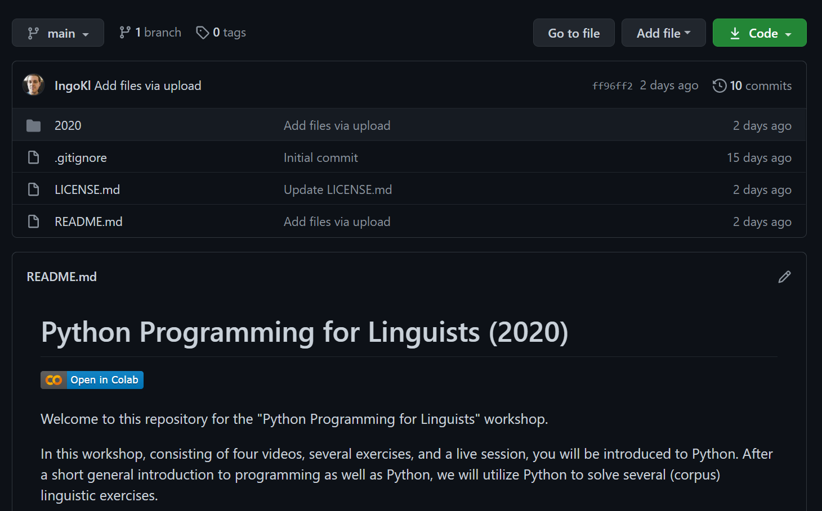
Coding Along
You can find all videos, materials, and exercises on GitHub.

Slide 5
Disclaimer
Everything that follows should be considered a (gross) oversimplification of reality!

Slide 6
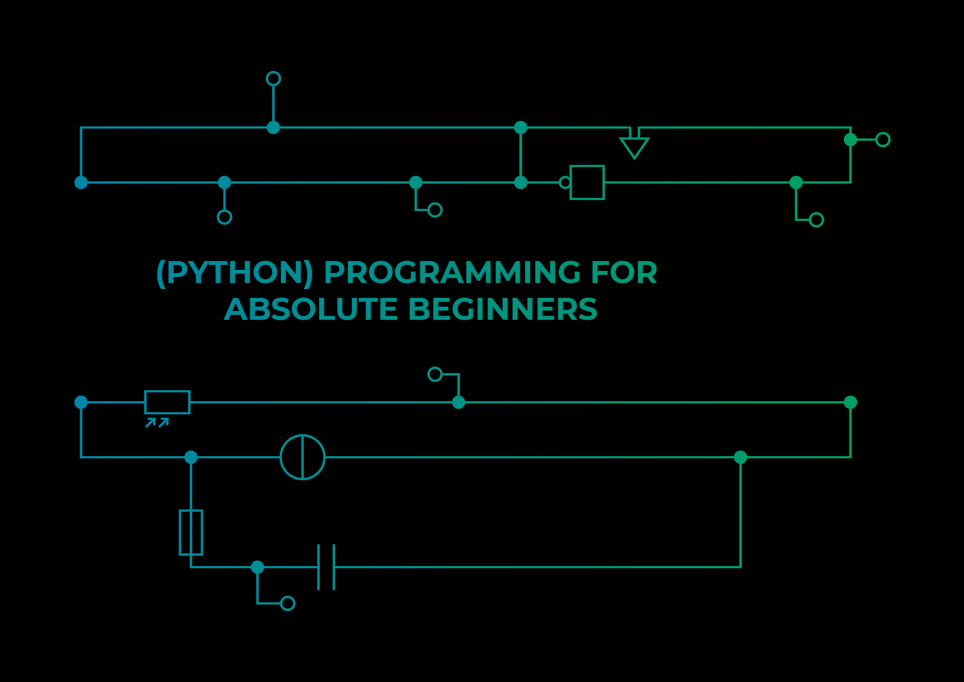

This Workshop
This workshop is heavily inspired by a number of workshops I held at 35c3 and 36c3.

Slide 7
00
Python Programming for Absolute Beginners
Python Programming for Linguists
Ingo Kleiber, 2020

Slide 8
Programming is …
Software Engineering
instructing machines and computers
problem solving
thinking differently (computationally)
modeling problems and other things
an art
science
fun
…
Scientific Coding
Everyday Coding

Slide 9
Programming
“It’s difficult not to have a love/hate relationship with computer programming if you have any relationship with it at all.”
(Rosenberg 2006)

Slide 10

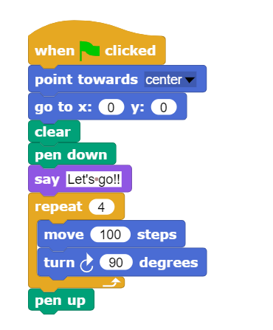
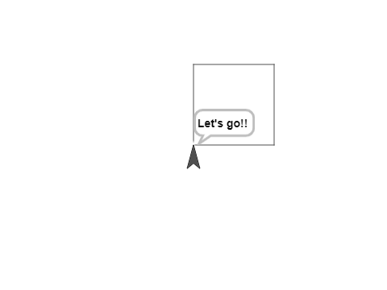
What Does Code Look Like? Snap!
Commands
Control Structure (repeat)

Slide 11
Python
Python is one of hundreds of programming languages.
free, open, and available on almost any platform
modern and widely used; there is a great community
relatively easy to learn; hard to master
legacy Python (2.x) vs. modern Python (3.x)

Slide 12

R
“R is a language and environment for statistical computing and graphics.”
(r-project.org)

Slide 13
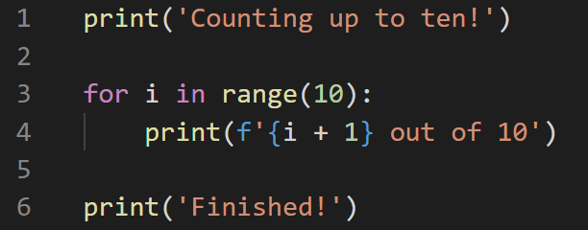
What Does Code Look Like? Python
Lines and Blocks
Command
calling a function print with an argument
= One command
Block / Control Structure
for loop
= Unit of functionality
Executed from top to bottom – line by line

Slide 14
Executing Python Code
My Code
Python
Results
Libraries
Script (e.g., helloworld.py)
Interactive (IPython)
Notebook
…
You will need Python on your system. There are various versions and distributions. For science, I would strongly recommend Anaconda.

Slide 15
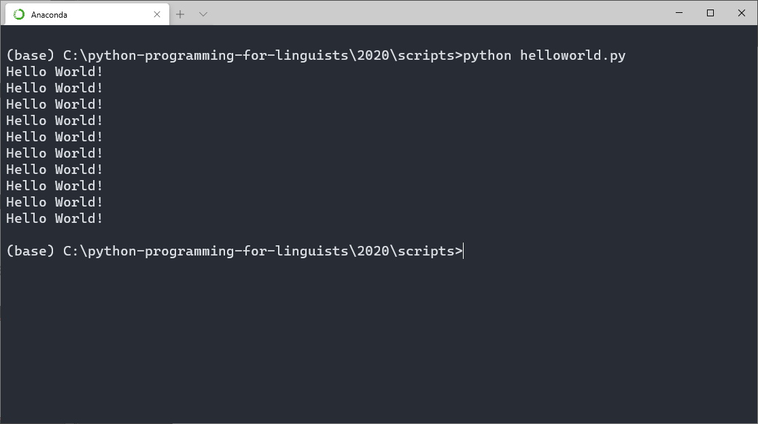
Script
Run the script helloworld.py using Python.
python helloworld.py

Slide 16
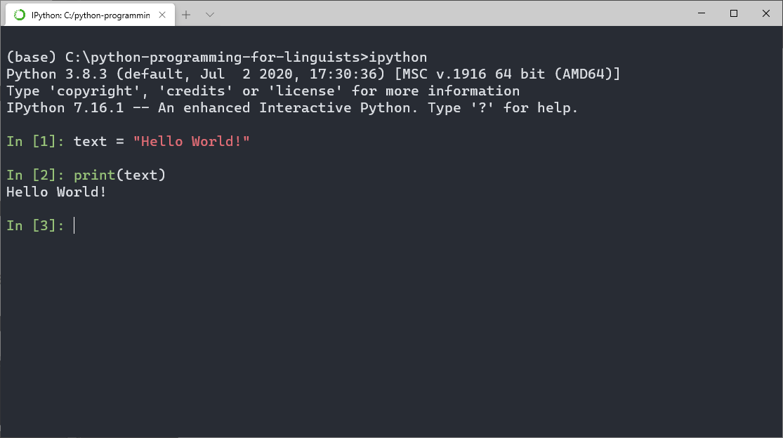
Interactive (using IPython)
ipython

Slide 17
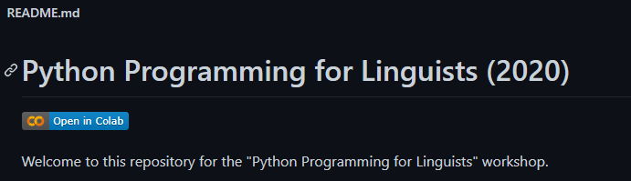
Our Tools
Have a look at Setting Up Your Development Environment
Git and GitHub in particular
Jupyter Notebook and Google Colab
If you have a Google account, you can run the exercises and notebooks directly via Google Colab.
If you do not want to rely on Google, you can install Jupyter locally and run the exercises this way.

Slide 18
Basics – The Building Blocks
Variables = a container to put data in (r = 13)
Lists = a list of data-things (e.g., variables) (l = [1,2,3])
Loops = repeating something until some condition is met
If-Constructions = do something if some condition is met
Functions = a unit of code that completes a specific task
Dictionaries = a data-thing that contains key: value pairs (cat = {'age': 2})

Slide 19
1. Variables
a = 13
b = ‘Hello World’
c = 42.42
Three variables (containers) of three different types:
integer, string, and float

Slide 20
2. Lists
A list (named l) containing 4 integers and the variable a.
l = [1, 2, 3, 4, a]

Slide 21
2. Lists
a =10
l = [1, 2, 3, 4, a]
1
2
3
4
a
We always start
counting at 0
0
1
2
3
4
l[0] → 1
l[3] → 4

Slide 22
2. Lists
la = [1, 2, 3]
lb = [4, 5, 6]
lol = [la, lb] → [ [1,2,3], [4,5,6] ]
la[1] → 2
A list of lists
lol[0][1] → 2

Slide 23
2. Lists
l = [1, 2, 3, 4, 5]
l.append(0)
l.append(3)
l.sort()

Slide 24
3. Loops
box = ['i0', 'i1', 'i2']
for item in box:
print(item)
i0
i1
i2
Step: 0
item: i0
Pos
0

Slide 25
3. Loops
box = ['i0', 'i1', 'i2']
for item in box:
print(item)
i0
i1
i2
Step: 1
item: i1
Pos
1

Slide 26
3. Loops
box = ['i0', 'i1', 'i2']
for item in box:
print(item)
i0
i1
i2
Step: 2
item: i2
Pos
2

Slide 27
4. If-Constructions
a = 10
if a > 15:
print (‘A is greater than 15’)
else:
print (‘A is not greater than 15’)

Slide 28
5. Functions
Two parameters which we pass to the function.
def add(a, b):
result = a + b
return result
What the function returns after calling
add(5, 10) → 15
add(2, 2) → 4

Slide 29
6. Dictionaries
word1 = { ‘lemma‘ : ‘cat‘, ‘pos‘ : ‘noun‘, }
Two key: value pairs
word1[‘pos‘] → ‘noun‘

Slide 30
Works Cited
Rosenberg, Scott. 2006. Dreaming in Code. New York: Three Rivers Press.

